Slide 1


Slide 2
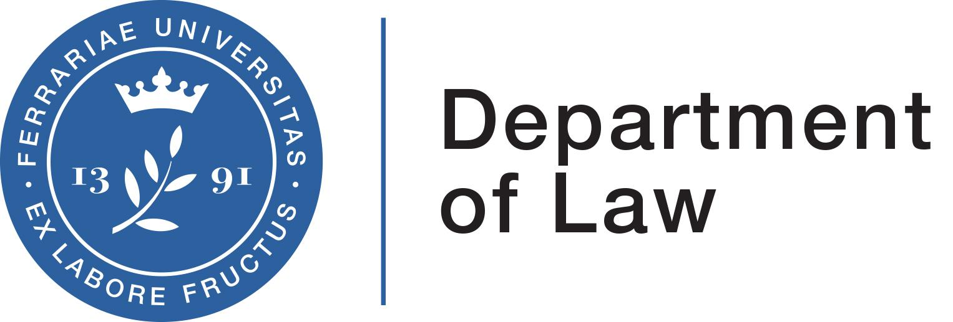
From ESG to social and fiscal sustainability
April 28th and 29th - Università degli studi di Ferrara
Polina Panova
Law student
Università degi studi di Ferrara

Slide 3
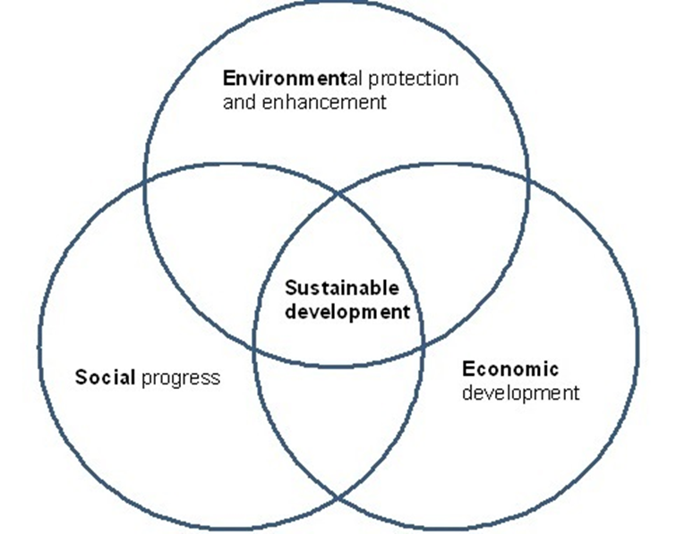
Sustainability development
Sustainability has become a central concept in global discussions in recent decades.
The term gained attention starting in the 1980s, initially referring to "human sustainability" in relation to our planet.
A crucial moment was the publication of the "Brundtland Report" in 1987, which defined sustainable development as: "Sustainable development is development that meets the needs of the present without compromising the ability of future generations to meet their own needs“.
In 1992, the Earth Summit in Rio de Janeiro made official the notion of sustainable development.

Slide 4
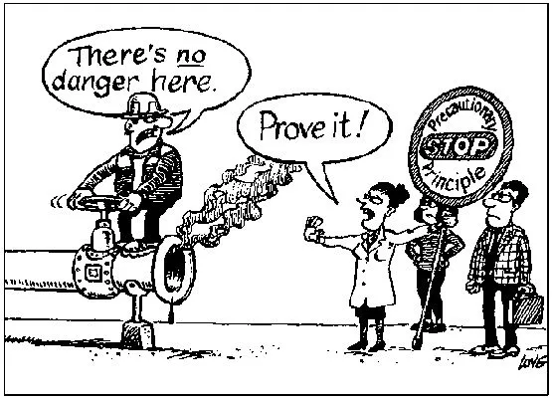
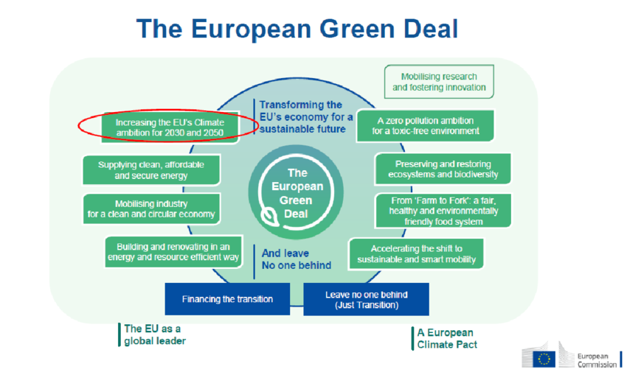
The steps to sustainable development
Initially, sustainability was mainly viewed in environmental terms, but it has evolved to include social and economic aspects as well.
Article 191 of the Treaty on the Functioning of the EU, the precautionary principle
The "polluter pays" principle, established by Directive 2004/35/EC
The European Green Deal
Corporate Sustainability Reporting Directive (CSRD) Directive 2022/2464

Slide 5
Sustainability
ESG
From primarily environmental concerns
To integrated approach including social and economic dimensions
Environmental impact
Social implications
Governance considerations
Growth of ESG Reporting

Slide 6

Environmental sustainability and regulatory framework
Italian and European regulatory measures:
Liability for Pollution Damages: Decree 152/2006; Articles 2043, 2050/2051 of the Italian Civil Code.
Legislative Decree 231/2001:Liability of legal entities for crimes by directors and employees.
Green Procurement: Law 221/2015 promoting green economy measures. Articles 57 and 108 of Legislative Decree 36/2023 on minimum environmental criteria in public procurement.
Law 120/2020:Empowers SACE to grant Green Guarantees for projects facilitating the transition to a clean economy.
Law Decree 21/2022 (Decreto Energia):Simplifies authorization for renewable energy production.
Importance of Environmental Reporting: focuses on how companies manage their environmental impact.
Main areas include:
Carbon Emissions
Resource Efficiency
Waste Management
Climate-Related Risks.

Slide 7
Social sustainability and regulatory framework
Social sustainability is focusing on a company’s performance regarding:
social issues like diversity,
labor practices,
community impact
corporate social responsibility (CSR).
These aspects reflect a company's commitment to social equity, employee welfare, and community engagement.
Italian and European regulatory measures:
Worker protection (Article 2087 Italian Civil Code; Legislative Decree 81/2008).
Anti-discrimination laws (Legislative Decrees 215/216/198/2006).
Child labor restrictions (Law 977/67).
Legislation against workplace harassment (Law 4/2021).

Slide 8
Governance sustainability and regulatory framework
Governance sustainability is concentrating on how company is directed and controlled
Main areas include:
Board Structure
Executive Compensation
Shareholder Rights
Transparency
Transparency in compensation structures (salary, bonuses, stock options, long-term incentives) is crucial for rewarding sustainable growth.
Italian and European regulatory measures:
Prohibition of Conflicts of Interest: Article 2391 of the Italian Civil Code.
Anti-Corruption Models: Required for state-owned or controlled companies (Law 190/2012).
EU Regulation 2088/2019 (SFDR): Establishes a framework for sustainable investment applicable to Italian market operators

Slide 9


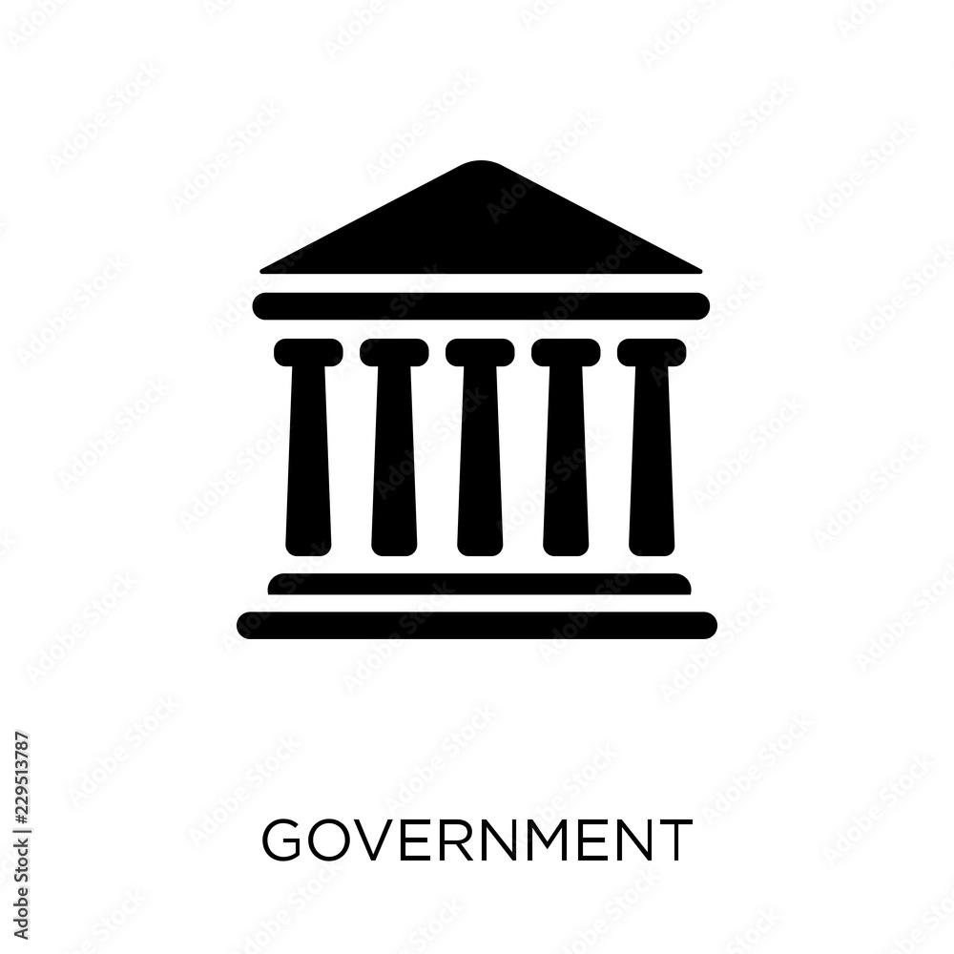

Case Study: Armani Group
Environmental sustainability
Reduction of greenhouse gas (GHG) emissions, approved by the Science Based Targets Initiative (SBTi).
In 2023 identified a regenerative agriculture project focused on cotton.
Since 2012, the Armani Group has been continuously updating its B2C packaging, which is made of approximately 90% certified paper and cardboard
Social sustainability
As of December 31, 2022, the Group employs 8,698 people (5% increase).
Women represent 62% of the workforce, with 51% in executive roles.
Commitment to diversity across various aspects, fostering a discrimination-free workplace
Governance sustainability
The Code of Ethics
A Model of Organization, Management, and Control (Model 231), for the prevention of crimes, in accordance with the provisions of Legislative Decree 231/2001 and subsequent amendments.

Slide 10
Conclusion
Sustainability represents a fundamental shift in how companies operate and engage with their stakeholders.
Sustainability has evolved from an environmental focus to an integrated approach that includes social and economic factors
There is growing importance placed on Environmental, Social, and Governance (ESG) criteria.
Various national and international initiatives, including tax incentives and environmental regulations, provide a framework for aligning corporate goals with broader societal objectives.
Future of Sustainability: It is crucial for companies to embrace sustainability as a core element of their business model, as evidenced by leading Italian companies adopting sustainable practices.

Slide 11
Thank You!

