Slide 1


Slide 2

EU tax law and policy making
April 28th and 29th - Università degli studi di Ferrara
Perini Lorenzo
Law student
Università degli studi di Ferrara

Slide 3
EU timeline
2014: NFRD
2019: EU Green Deal
2015: UN 2030 Agenda & Paris Agreement
2024: CSDDD
2019: SFDR
2021: April Package
2001: Green Paper on Corporate Social Responsibility
2020: EU Taxonomy Regulation
2022: CSRD

Slide 4

From Ethics to Law
CSR roots: 1920s–1980s ethical theories on Corporate Social Responsibility
Our Common Future: the Brundtland Commission Report (1987). Sustainable Development as the «development that meets the needs of the present without compromising the ability of future generations to meet their own needs».
ESG evolved from voluntary ethics to normative legal influence
In the EU, ESGs now shape legislative and policy frameworks, especially in tax law

Slide 5
Early EU steps
2001: EU Green Paper on CSR and the concept of socially responsible company
2014: Non-Financial Reporting Directive (NFRD)
Applies to large public-interest companies (around 11.600 entities)
Requires annual Non-Financial Statement (NFS)
Shift from voluntary to mandatory non-financial reporting
Aim: improve transparency, support stakeholders

Slide 6

Meanwhile: the global framework
2015: UN 2030 Agenda introduces 17 SDGs aligned with ESG
SDG 12.6 encourages «companies, especially large and transnational companies, to adopt sustainable practices and to integrate sustainability information into their reporting cycle»
2015: Paris Agreement

Slide 7
2019–2021: EU Green Finance Framework
2019: the European Green Deal and its vision for climate-neutral EU by 2050
2019: Sustainable Finance Disclosure Regulation (SFDR):
Transparency on ESG risks in investments
2020: EU Taxonomy Regulation (2020/852):
Classifies sustainable economic activities
Prevents greenwashing, channels sustainable investment
2021: April Package – integration of SFDR, Taxonomy, and ESG benchmarks

Slide 8
CSRD: A New Reporting Era
The Corporate Sustainability Reporting Directive (CSRD, 2022): Replaces NFRD, it expands scope to 49,000 + companies in the EU
Key principles: double materiality, due diligence, digital tagging
Requires use of European Sustainability Reporting Standards (ESRS: tailored to the regulatory objectives of European institutions)

Slide 9
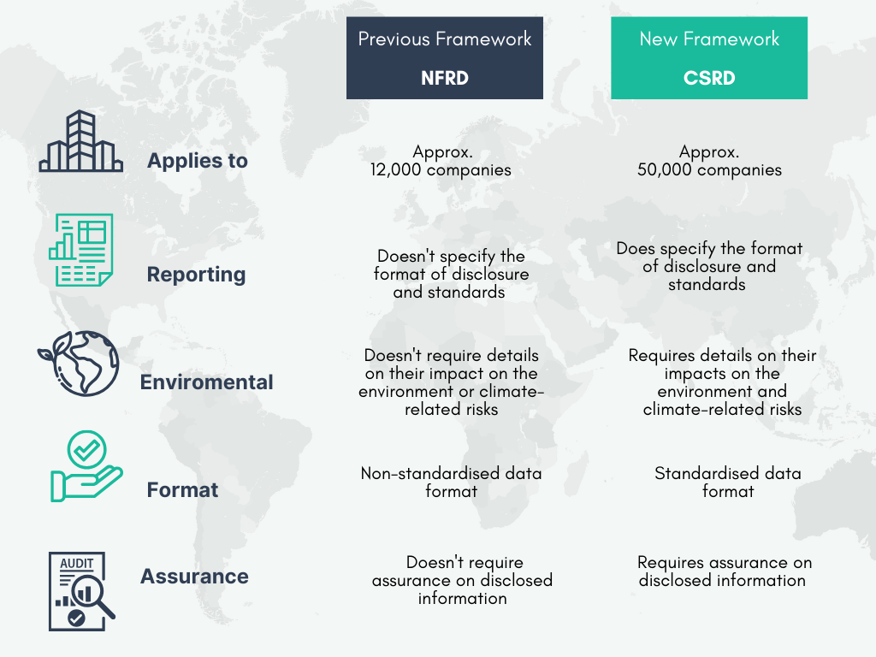

Slide 10
ESRS (2023) & CSDDD (2024)
ESRS (2023): formal adoption of these standards by the EU Commission
CSDDD (2024): introduces mandatory due diligence on human rights and environmental risks
Reinforcing the EU’s role as a global legal leader in sustainable governance

Slide 11
Thank You!

