Slide 1

Matching Credit in the ESG Context.
Tax Incentive or Environmental Contradiction?
Anna Miotto, University of Ferrara
Ferrara, April 28th – 29th, 2025

Slide 2

Outline of the Presentation
The importance of ESG criteria;
The phenomenon of Matching Credit under the DTCs;
ESG rating Agency;
Conclusion.

Slide 3
The role of ESG criteria
ENVIRONMENTAL
Change the way to make BUSINESS
                from shareholder to stakeholder;
                Easier access to finance and investors
                greater attractiveness to investors and better financing conditions;
                Better reputation and customer loyalty
                a strong ESG commitment strengthens the company’s reputation;
                Reduction of tax and legal risks
                the integration of ESG criteria helps companies identify and mitigate risks (tax);
                Regulatory compliance and competitive advantage
                es. CSRD; CS3D; Taxonomy Regulation etc.
SOCIAL
GOVERNANCE
1

Slide 4

The Italian Perspective
Pursuant to Article 165 of the Italian Income Tax Code, Italy grants a tax credit for taxes paid (definitively) abroad.
If income earned abroad contributes to the total income, the taxes definitively paid abroad on such income are allowed as a deduction from the total tax payable up to the amount of the tax corresponding to the proportion of the income earned abroad to the total income after deducting losses from previous tax periods.
2

Slide 5




The Matching Credit
The matching credit is a particular form of tax credit or... incentive.
Mechanism that aim at mitigating the effects of international double taxation even in cases where the foreign tax has not actually been paid, but is “virtually due” by virtue of foreign facilitating regimes.
The credit may be granted even if there is no actual payment of the tax, provided that the taxpayer has been objectively subjected to a foreign tax, even in the absence of effective Taxation.
Temporary exemptions for Foreign Investors.
Provided in certain double tax treaties.
As a rule, the deduction is provided for in a fixed amount.
Purpose: facilitate investments in developing countries.
3

Slide 6
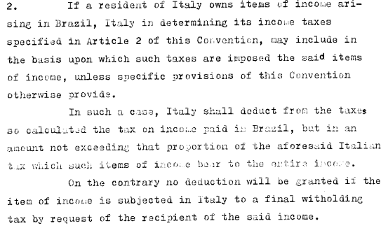
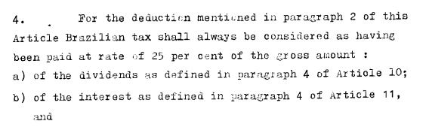

..in the DTCs
DTC Italy – Brasil, art. 23: «Method for the elimination of double taxation».
(The same: Italy – Philippines, Italy – Argentina)
4

Slide 7

What is the link between Matching Credit and ESG?
5

Slide 8
The relation with ESG
Matching credit is conceived as an incentive to localize investments abroad, especially in developing countries.
The problem from an ESG perspective is to favour investments in environmentally or socially critical sectors without any sustainability-related constraints.
Is it coherent to incentivise an investment in a carbon-intensive plant or in companies without human rights protection?
The effect may be contradictory: the developed state (in this case, Italy), while formally committed to sustainability policies, ends up supporting activities that are not consistent with environmental and/or social objectives, and benefits from the exemption without, however, having to comply with European environmental standards.
6

Slide 9
ESG as an interpretative limit?
There are currently no regulatory provisions expressly linking the tax credit (Matching Credit) to ESG criteria.
An interpretative or even legislative development in this sense can be hypothesized:
exclusion of the matching credit for investments in “non-green” sectors like coal, oil, energy;
conditioning of the credit to compliance with minimum environmental parameters (e.g. certifications, environmental audits);
linkage with the European Union's green taxonomy.
7

Slide 10
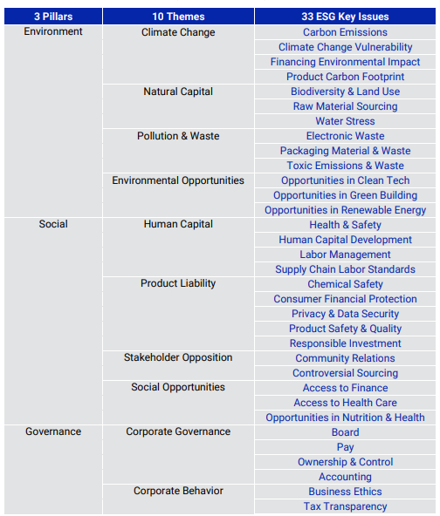

ESG Rating Agency
Rating agencies may negatively evaluate the impact of companies abroad through financing activities that are not compliant with ESG criteria.
Likewise, a focus on ESG issues can raise the rating.
It is all a matter of rating and scoring.
8

Slide 11

Conclusion and possibile development
From a systemic perspective, the integration of ESG principles into international tax law seems desirable.
In particular, it could be envisaged:
ESG filters for the access to foreign tax credit, both in domestic legislation (art. 165 TUIR) and in convention;
amendment of bilateral treaties, introducing “eco-conditionality” clauses for tax sparing and matching credit mechanisms;
mandatory ESG reporting for companies availing of these benefits, in line with the CSRD directive.
9

Slide 12
Thank you
Anna.miotto@unife.it

