Slide 1
PROBLEMS OF DEFINING THE ROLE OF BANKS IN TAX ADMINISTRATION
Karaganda Buketov University
Prepared: Nurbekova G.T.
Karaganda

Slide 2
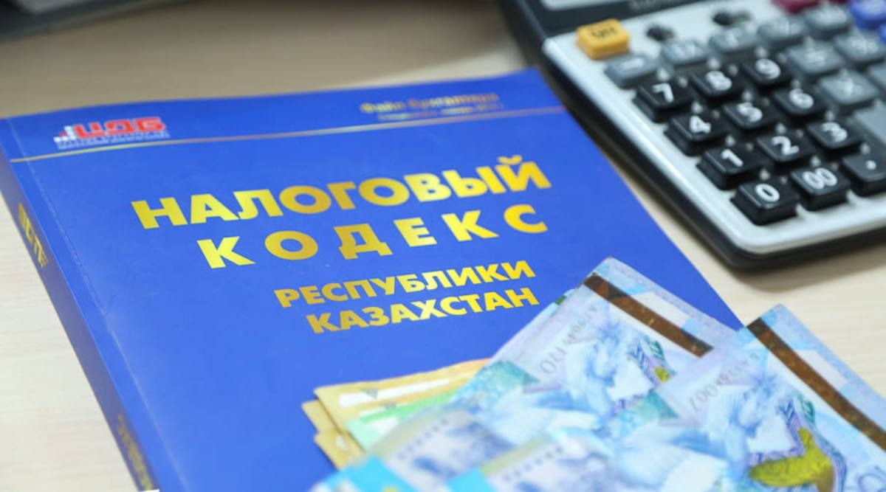
According to Article 68 of the Tax Code of the Republic of Kazakhstan, "Tax administration is a system (set) of measures and methods implemented by tax authorities and other authorized state bodies to collect taxes and payments to the budget, including the implementation of tax control, the use of methods to ensure the fulfillment of a tax obligation not fulfilled on time and measures of compulsory collection of tax debts, as well as the provision of public services and other forms of tax administration established by the Code"

Slide 3
Issues of interaction between banks and tax authorities are always relevant and affect the interests of not only banks, but also their taxpayer clients. Maintaining a balance between measures related to banking secrecy and tax control over the banking activities of taxpayers depends on meeting the requirements in accordance with the established procedure of the provisions of current legislation.

Slide 4
Certain difficulties and problems arise in the field of tax administration of banking activities in the Republic of Kazakhstan, which are caused by imperfection of legislation, which creates the possibility for its ambiguous interpretation. The solution to the problem is complicated by the lack of an accurate definition of the institution of tax administration, which violates one of the basic principles of taxation – the certainty of the tax system.
The issues of tax administration of banks have a dual structure, since on the one hand, tax regulations should pursue the goals of maintaining the stability and stability of the banking system, and on the other hand, they should take into account the influence of banks on the pace of economic development of the country and their role in filling the budget as participants in tax relations.
On the one hand, the bank is a legal entity in the form of a joint-stock company and acts as an independent taxpayer, and on the other hand, it is an important link in tax relations and an essential element of the tax system. The issue of the status of commercial banks has been raised repeatedly, but has not yet been fully resolved.

Slide 5
A bank is a legal entity that is a commercial organization that, in accordance with the Law of the Republic of Kazakhstan "On Banks and Banking Activities in the Republic of Kazakhstan", is authorized to carry out banking activities.
The Bank as a legal entity operates on the basis of a license issued by the authorized body - the Agency of the Republic of Kazakhstan for Regulation and Development of the Financial Market (hereinafter – the Agency)
The Bank has the exclusive right to carry out in aggregate the following types of banking operations established by Article 30 of the Law of the Republic of Kazakhstan "On Banks and Banking Activities in the Republic of Kazakhstan".

Slide 6
Banking operations
Accepting deposits
Opening and maintaining bank accounts of individuals
Оpening and maintaining bank accounts of legal entities
Оpening and maintaining correspondent accounts of banks and organizations engaged in certain types of banking operations

Slide 7
Based on this, the bank is created and operates like any other commercial organization and the main purpose of the bank is to generate profit and distribute it among shareholders. However, banks have statutory powers and responsibilities that allow banks to be placed in a special position with specific functions in the tax administration system

Slide 8
Ways to ensure the fulfillment of a tax obligation that has not been fulfilled on time (paragraph 2 of Article 116 of the Tax Code of the Republic of Kazakhstan)
Suspension of expenditure transactions on bank accounts (except for correspondent ones) of a taxpayer (tax agent) – a legal entity, a non-resident operating in the Republic of Kazakhstan through a permanent establishment, an individual entrepreneur, a person engaged in private practice;
Suspension of expenditure transactions on the cash register of a taxpayer (tax agent) – a legal entity, a structural subdivision of a legal entity, a non-resident operating in the Republic of Kazakhstan through a permanent establishment, an individual entrepreneur, a person engaged in private practice;
Restriction on the disposal of the property of a taxpayer (tax agent) – a legal entity, a structural subdivision of a legal entity, a non-resident operating in the Republic of Kazakhstan through a permanent establishment, an individual entrepreneur, a person engaged in private practice

Slide 9
Another of the bank's obligations at the request of the tax authorities is the measures of compulsory collection of tax debts.
Compulsory collection of tax debts is carried out at the expense of money held in bank accounts on the basis of a collection order of the tax authority, with the exception of the amount of money that is collateral for loans issued by such a second-tier bank or an organization engaged in certain types of banking operations, in the amount of the outstanding principal debt of the specified loan.
It should be added here, with the exception of money provided for by banking legislation, since this is not the only case according to the norms of current legislation when a bank can refuse to the tax authorities
The collection order is drawn up by the tax authority on the basis of data on the amount of tax arrears as of the date of its compilation (paragraph 2 of Article 122 of the Tax Code of the Republic of Kazakhstan). By itself, the measure to ensure that organizations fulfill their tax obligations does not cause complaints, however, when it is executed, various points arise regarding the status of the bank in relations with state revenue authorities, since this issue has not yet been fully settled by the legislator.

Slide 10
Let's consider some of them, so in accordance with Article 285 of the Administrative Code of the Republic of Kazakhstan, non-fulfillment by banks and organizations engaged in certain types of banking operations of obligations established by the tax legislation of the Republic of Kazakhstan, committed in the form of:
• failure to notify the state revenue authorities about the opening of bank accounts to a taxpayer - a legal entity, including a non-resident, its structural divisions, an individual registered as an individual entrepreneur, a private notary, a private bailiff, a lawyer, a foreigner and a stateless person through transmission over an information and communication network that ensures guaranteed delivery of messages, no later than one working day following the day of their opening, or when sending a paper notification - within three working days;

Slide 11
• Оpening a new bank account for his client if the latter has an open bank account in this bank, to which collection orders or orders on suspension of expenditure transactions on taxpayer's bank accounts have been issued by the state revenue authorities,
- entails a fine in the amount of five percent of the amount of expenditure transactions performed on taxpayers' bank accounts for the period of non-fulfillment by the bank of obligations established by the the tax legislation of the Republic of Kazakhstan .
Consequently, the bank is liable from its own funds in case of improper fulfillment of obligations, as a payment organization, i.e. as an intermediary.

Slide 12
It turns out that the tax authorities have the right to make inquiries to banks regarding transactions and cash balances on taxpayers' accounts, the tax authorities have the opportunity to exercise control in the tax administration system. In fact, information should be provided to the tax authorities in case of a possible offense in the field of tax relations of a particular taxpayer.
The second paragraph of the same Article 285 of the Administrative Code of the Republic of Kazakhstan establishes the responsibility of the bank again as an intermediary in the tax administration system.
Non-transfer or late transfer by banks and organizations engaged in certain types of banking operations of tax amounts to the budget placed under conditional bank deposit agreements,
-entails a fine in the amount of fifty percent of the amount of non-transferred or untimely transferred tax and other mandatory payment to the budget placed on a conditional bank deposit.
The bank is also subject to various penalties from the National Bank of Kazakhstan and the Agency of the Republic of Kazakhstan for Regulation and Development of the Financial Market for non-compliance with regulations or violations in the field of taxation.

Slide 13
Therefore, banks fully comply with the requests of the state revenue authorities. And here, it is worth noting that many requirements, such as the compulsory collection of tax debts at the expense of money held in bank accounts on the basis of a collection order, are carried out without legal expertise on the basis of the bank's internal regulations.
In this regard, we assume that by forcing banks and tax authorities to work in the same chain, the legislator should take into account the interests of the bank, allowing them to participate in the development of a mechanism for interaction, simply prescribing their powers in tax legislation.

Slide 14
On the other hand, banks themselves are involved in the tax administration process. Their status in this process does not coincide with the status of taxpayers (or tax agents), nor with the status of tax authorities.
Taxpayers choose different ways of paying taxes (through a tax agent, by self-payment, through electronic terminals, etc.) money is transferred to the budget by wire transfer. Nevertheless, the main figure, the main intermediary in tax relations is always the bank.
Based on this, it is worth analyzing the opinions of various scientists, lawyers and economists on determining the place of banks in the tax administration system

Slide 15
Banks occupy a special position in the tax system. This is due to the fact that banks participate in tax legal relations not only in connection with the execution of payment documents, collection orders and decisions of tax authorities, but also as independent taxpayers or tax agents, as well as as a tax intermediary between the state and taxpayers.
Thus, defining the role of banks in the tax administration system, it should be noted that, on the one hand, their special legal status as intermediaries is not legally defined, and on the other, it would not be quite correct and correct to consider banks only as taxpayers and tax agents.

Slide 16
Groups of economic entities according to the form of their participation in the process of tax administration (V.E. Kuznetsenkova):
Tax administration bodies
Persons who assist in tax administration

Slide 17
An interesting point of view is Yu.V. Chernova, who believes that when characterizing tax legal relations in relation to their participation in tax administration, it is more correct to refer banks to the main group of persons along with tax, financial and customs authorities. In this mechanism of interaction, the author highly appreciates the place of banks in the tax control system

Slide 18
According to L.I. Goncharenko, such a conclusion, firstly, contradicts the definition of tax control given in Article 82 of the Tax Code of the Russian Federation, from which it follows that the subjects of tax control include authorized bodies, in the list of which credit organizations are rightly absent. Because, secondly, it contradicts the principles of interaction between banks and customers, including the norms of compliance with banking secrecy established by law. Accordingly, everything related to the interaction of tax authorities and banks should be clearly spelled out in the legislation on taxes and fees from both a substantive and procedural point of view.
Another opinion deserves attention, as S.G. Pepelyaev notes, that the bank does not act as a representative of the taxpayer to the state, but as a representative of the public interests of the state.

Slide 19
Based on all of the above, studying the role of banks in tax administration, it can be concluded that the bank can only assist the state revenue authorities in the management of tax administration, acting as a tax intermediary, only technically ensuring the receipt of taxes to the budget. At the same time, the bank does not act as a representative of the taxpayer to the state, but as a representative of national interests. In the research of most scientists, tax relations with the participation of a bank are considered unilaterally - from the point of view of their relationship with tax authorities, in fact, banks perform a variety of functions and have a wide range of responsibilities, which reflects their special role in tax relations.

Slide 20
In conclusion, it is worth noting that the practice of tax administration shows that the tax authorities and banks, performing the same important tasks of collecting taxes for the state, stand in opposite positions. This is due to the fact, as noted above, banks themselves are independent taxpayers, tax agents and intermediaries between the tax authorities and other taxpayers, providing the tax authorities with the necessary information to verify the correctness of the calculation and timely payment of taxes to the budget. And until the status of banks is regulated by law, their positions on this issue will only diverge.

Slide 21
Nevertheless, the issue of merging banks with tax and customs authorities or banks into a group with other entities that ensure that taxpayers fulfill their tax obligations does not make sense unambiguously. This is due to several reasons, firstly, banks are not bodies specially created for the purposes of tax administration, and secondly, the role of banks in the banking system is very significant, it is key and their role in the structure of tax administration consists in intermediary functions between taxpayers and tax authorities.

Slide 22
Summing up the consideration of various positions regarding the definition of the role of banks in the mechanism of tax administration, it should be noted that banks play a dual role in this case.
Based on the above, the role of banks in tax relations can be supplemented by the following provisions. Banks can act as an executor of orders from tax authorities in the tax administration system, as well as a control body for the movement of money, both banks themselves and their clients, assisting tax authorities in the field of accounting and control of taxpayers, creating new financial technologies that improve the tax collection system and increase the level of control over financial flows.

Slide 23
Banks are subject to tax administration
Аs taxpayers and tax agents
Сarry out activities as special participants in tax relations

Slide 24
There is a need for a broader interpretation of the content of monitoring compliance with tax legislation by banks as an integral part of tax administration. The inclusion of monitoring of the development of the tax system in tax control, which will make it possible to predict and assess the consequences of introduced or proposed legislative changes in terms of ensuring the effectiveness of control measures, as well as significantly reduce the tax risks of the state when banks use various tax optimization schemes.
The current tax legislation in the Republic of Kazakhstan does not impose a special tax on banks, considering them as a legal entity from the point of view of taxation, but taking into account certain features, and accordingly banks have a special tax and legal status, which needs to be clarified and approved at the legislative level.

Slide 25
List of literature:
1. Code of the Republic of Kazakhstan dated December 25, 2017 No. 120-vi "On Taxes and other mandatory payments to the Budget" (with amendments and additions as of 01.01.2023) http:// online.zakon.kz›
2. Law of the Republic of Kazakhstan dated August 31, 1995 No. 2444 On Banks and Banking activities in the Republic of Kazakhstan (with amendments and additions as of 01/12/2023) http:// online.zakon.kz›
3. The Code of the Republic of Kazakhstan on Administrative Offenses (with amendments and additions as of 02/06/2023) http:// online.zakon.kz "
4. Winter O.V. Discussion on the place and role of commercial banks in the tax administration system. //Taxes. 2012. No. 3. pp. 8-10. //elibrary.ru "item.asp?id=18229565
5. Kuznetsechenkova V.E. Procedural procedure for bringing banks to tax liability // Banking law. 2004. N 4. – pp.50-56

