Slide 1

Karaganda Buketov University
CHALLENGES IN AML REGULATION IN TAXATION
Madina Albekova
PhD Candidate

Slide 2
Introduction
money laundering and tax crime
Money laundering and related tax crimes are global problems that affect the economies of all countries. Systems designed to prevent tax crimes and related money laundering have weaknesses that allow them to persist and deprive jurisdictions of important tax revenue.

Slide 3





THE MAIN SOURCES OF ILLICIT PROCEEDS THAT CRIMINALS SEEK TO LAUNDER IN THE REPUBLIC OF KAZAKHSTAN
drug trafficking
shadow economy
tax evasion
corruption
cybercrime

Slide 4

domestically
Problems
Due to the large domestic shadow economy and the prevalence of cash-based financial transactions, domestic tax crimes occur in the form of tax evasion
internationally
Internationally there is an increase in corporate and offshore income from private individuals' financial assets

Slide 5

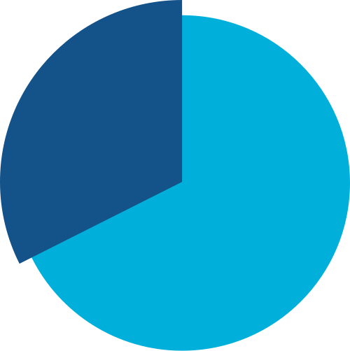
97
the loss from tax evasion
93
32
2021
2022
11 months 2023
226.3 billion tenge
(around 300 million euros)
with an average of 424.6 million tenge (around 900,000 euros) per crime
Number of registered offences under the article "evasion of taxes and other obligatory payments to the budget from organisations"

Slide 6

Kazakhstan withdraws $3-6 billion dollars annually due to offshore
$176.6 million
Seychelles
Cayman Islands
$637.5 million
2021 indicators

Slide 7









Beneficial owners
legal entity transparency
public access
register of beneficial owners

Slide 8
COMPLIANCE MONITORING
Compliance/Legal Compliance
AML/CFT
Ethics/Anti-Corruption
involved in the processes of identifying deficiencies and violations of the requirements of the legislation of the Republic of Kazakhstan
involved in AML/CFT processes
involved in the processes of maintaining ethics of the organization at a sufficient level, as well as combating corruption

Slide 9
Conclusions
The difficulty of identifying criminally derived funds in the global financial system has given the world's developed nations the idea of the need for collective action to combat money laundering, including in the tax area.
They are complex legal structures with companies and trusts often spanning multiple jurisdictions, a common feature of tax offenses and related money laundering schemes. The transparency of the beneficial ownership of legal entities and legal agreements is intended to identify criminals using these structures and to provide intelligence to the relevant authorities as part of their analyzes and investigations.

