Slide 1


Slide 2

The Wealth Tax:
OECD perspective on wealth tax: analysis of trends in its member states
Università degli Studi di Rovigo
10/03/2023

Slide 3
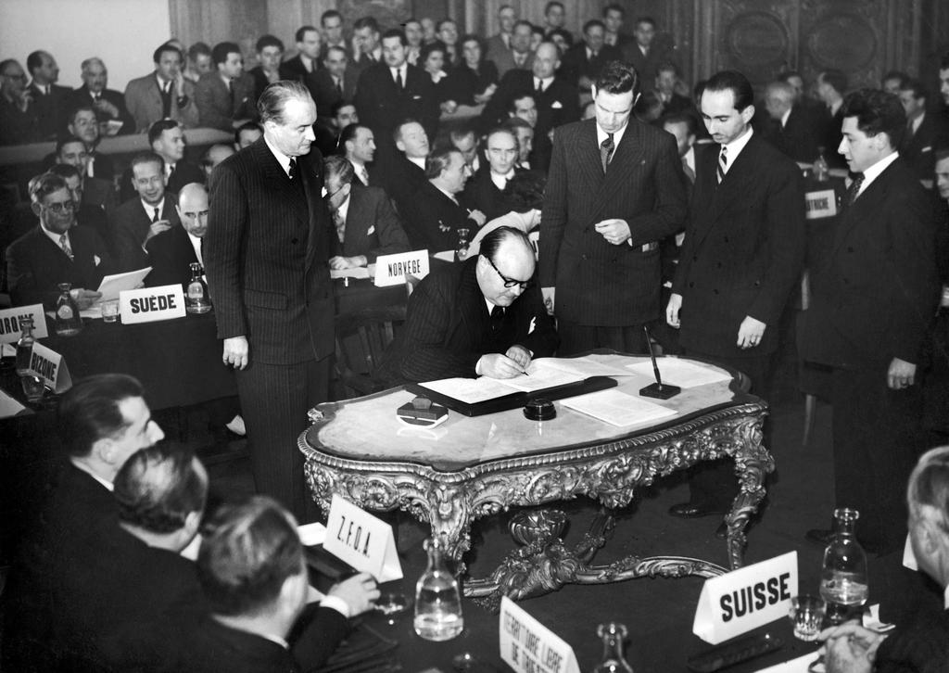

Historical background: from OEEC to OECD, the consistency of the objectives within the international framework:
1948
1960
The OEEC was to coordinate activities and resources between member states and enhance the European economy after World War II.
The OECD was established and succeeded the OEEC.
Belgium signs the OEEC Charter, Paris, 16 April 1948
The OECD continues the goals of contributing to economic development and coordination between member states.
OEEC encouraged relations between members through bilateral and multilateral agreements and aimed to expand economic policies.
The OECD currently has 38 members, including founder states of the OEEC, several EU countries, the United States, Canada, Japan, Australia, New Zealand, Mexico, South Korea, Costa Rica, Chile, Colombia, and Israel.
However its objectives could be achieved only through a revision

Slide 4

Scope of the Net Wealth Tax:
What is a Net wealth tax?
PEOPLE!
Net Wealth Tax is annually levied by taking as tax base, the wealth possessed by individuals.
Individuals’ wealth comprehends several assets as properties, personal cars, fixed assets, bank deposits, shares.
But, is Net Wealth Tax an efficient measure according to OECD studies?
Promotion of social equity and of sustainable economic growth
To reduce income inequality, generate revenue for public services and reduce the lack of social cohesion.
Wealth Tax is distinguished from taxes on capital income, which are levied on the flow of income generated by assets such as dividends, interests.

Slide 5
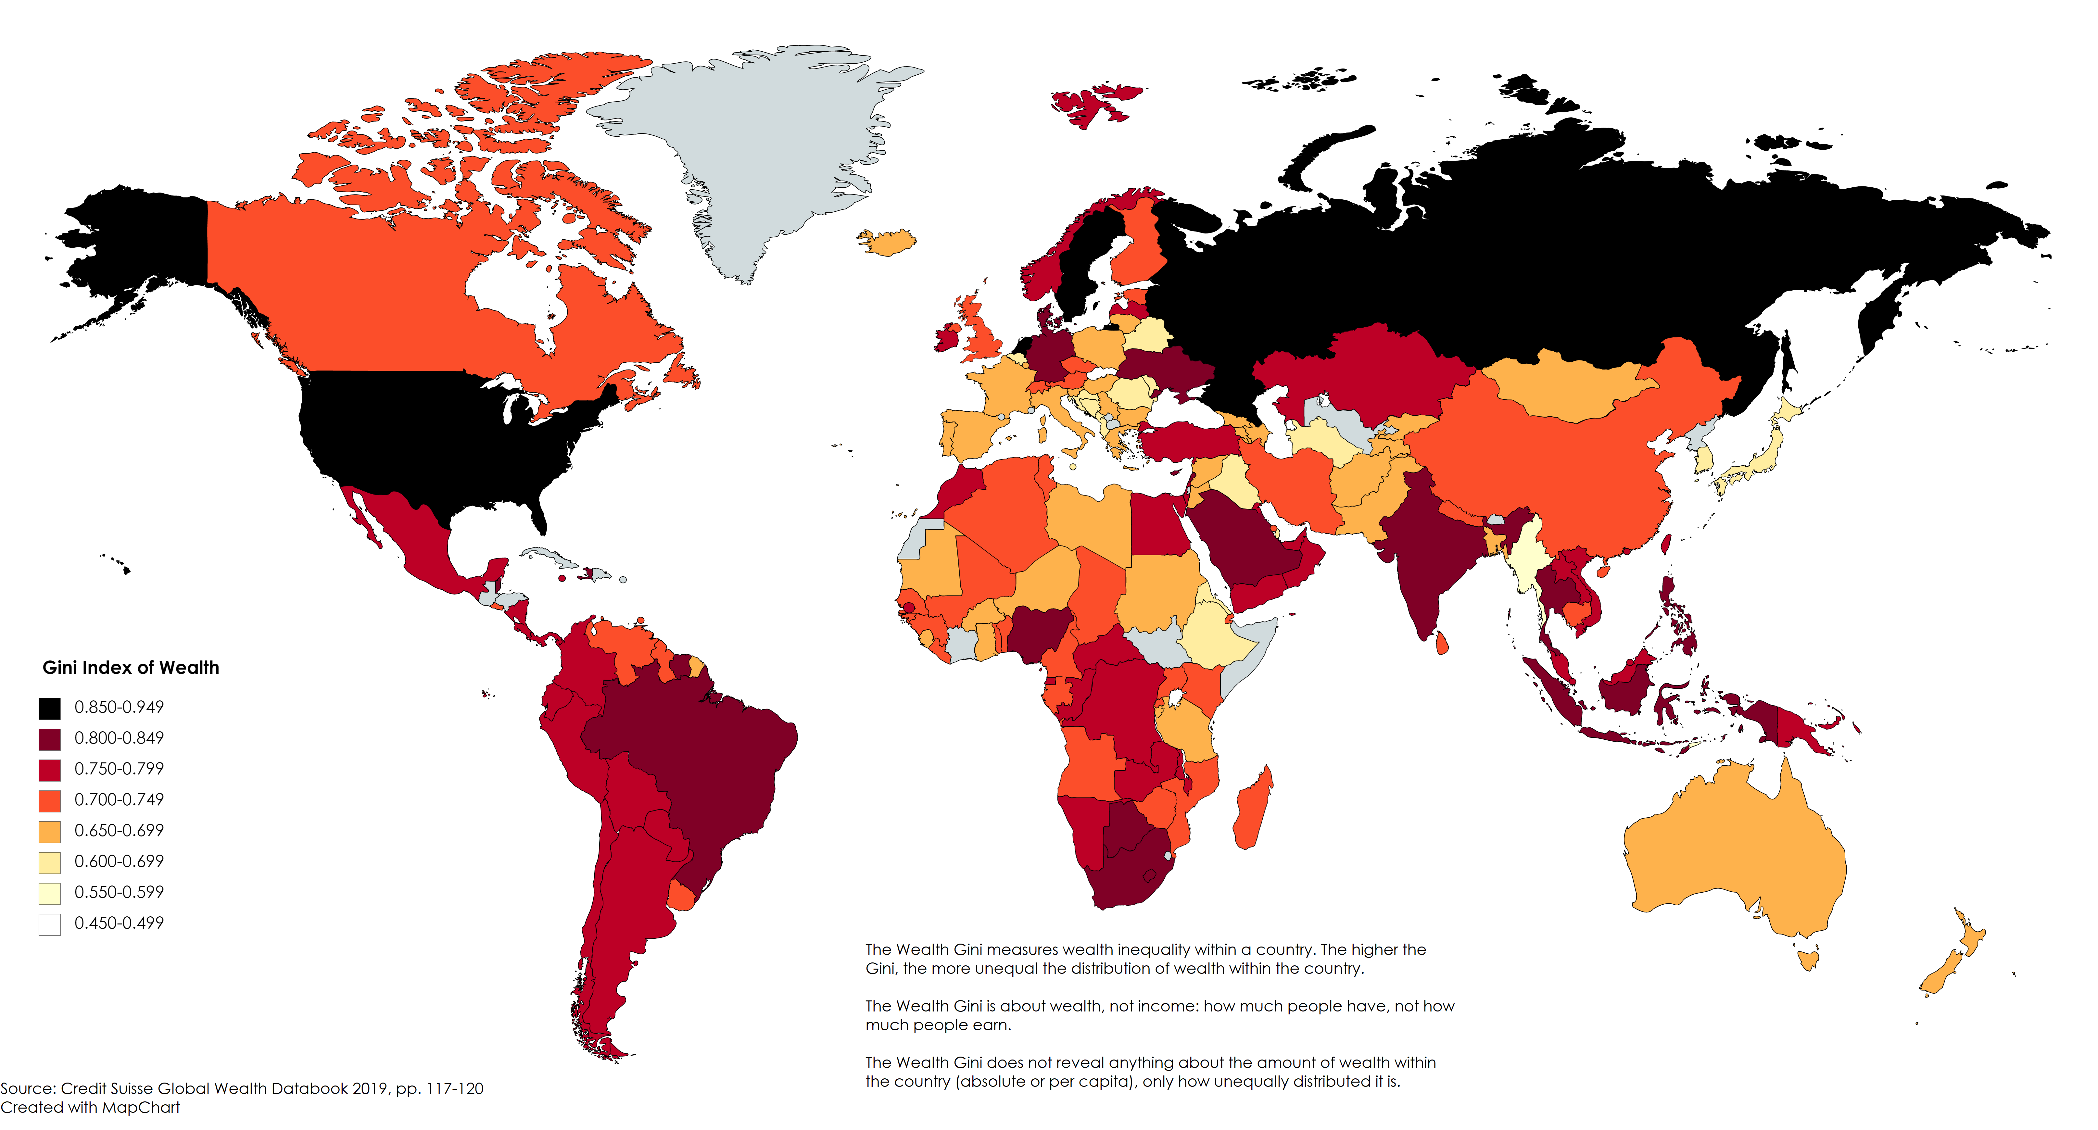
The reasons of wealth inequality according to OECD studies:
Which are the factors that led to income inequality?
Skill-biased technical change (SBTC) associated with new technologies
Specific factors within each country:
Economic development and stability,
domestic policies,
Globalisation and liberalisation of factor and product markets.
Important: OECD analysis on relations between wealth and income:
The reason why there is such discrepancy in wealth distribution is that wealth tends to be more concentrated in a limited group of individuals which inevitably tends to coincide with high income earners.
It is much more probable that those who earn a high income are more likely to have high levels of wealth, on the contrary, those who earn a lower income tend to have lower level of wealth.

Slide 6
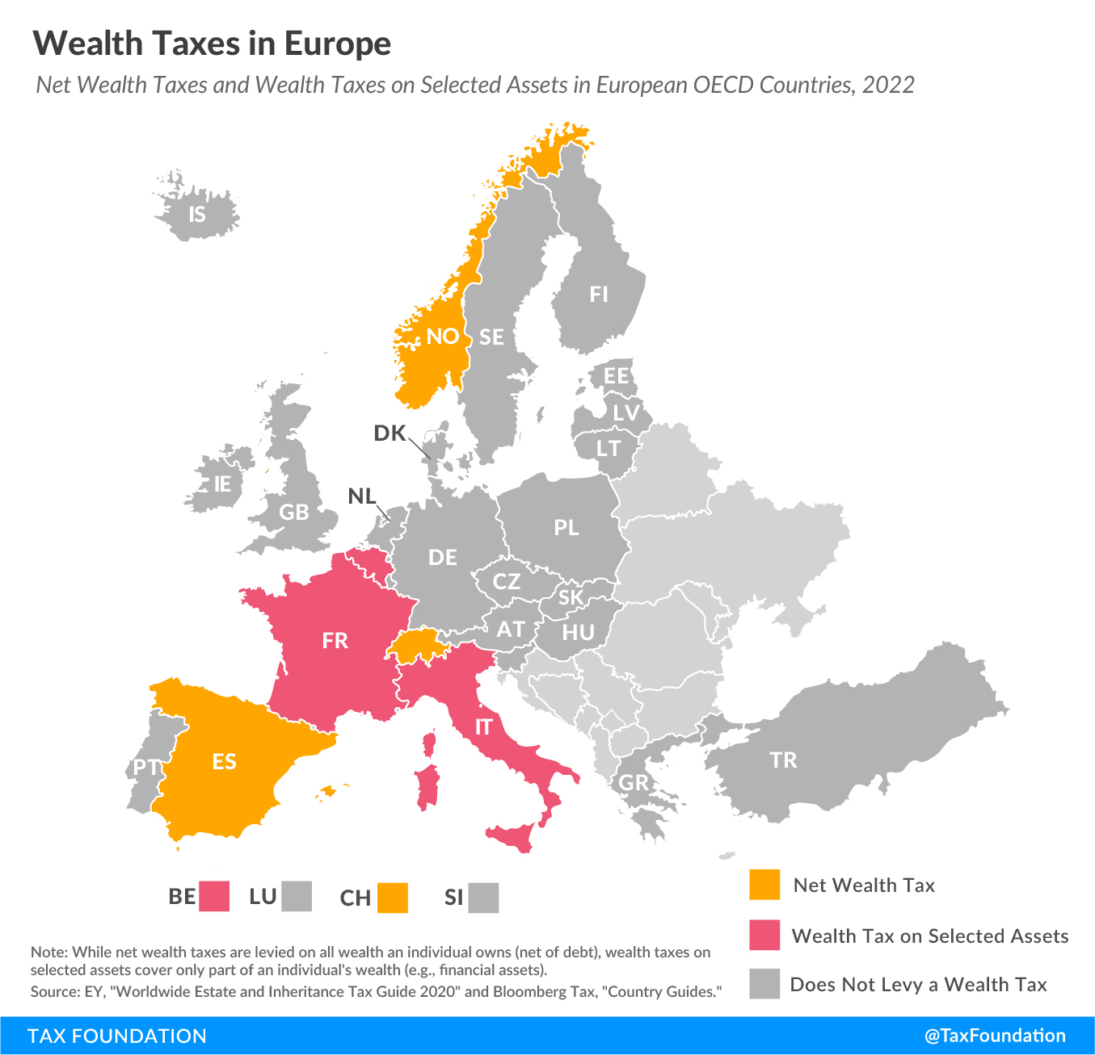
Overview on net wealth tax:
Net wealth taxes have always been unpopular within member states
Countries that apply net wealth taxes dropped from 12 to 4 from 1990 to 2017.
However, the effectiveness of such tax must be evaluated on the basis of formal and factual factors within each state.
Formal factors:
Targeted assets
Tax rates,
Possible exemption
Factual factors:
Wealth distribution,
Propensity to avoid taxes
The tax policy in other countries

Slide 7
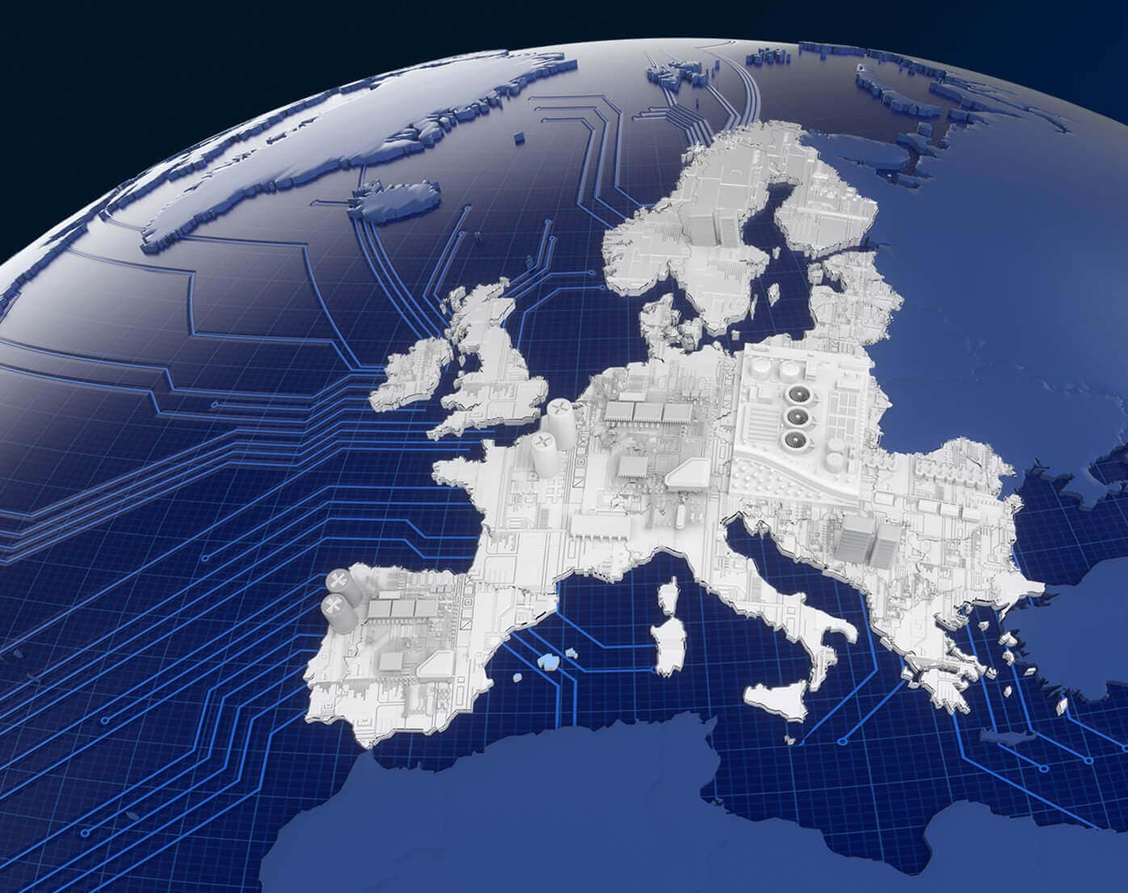
Prospectus on the wealth tax policies in the OECD members: particularly sources of national legislation, exemption thresholds; the general trends
Design the tax: legislative sources:
Several countries have adopted family as tax unit: individuals that belong to the same family are taxed jointly,
The levying of wealth tax can vary according to each Government discretionality
Wealth tax at national level
General provision that can be derogated within certain aspects, by regional legislative power.
Exemption thresholds:
The general trend shows that according to the exemption threshold set out by each state, wealth tax is most frequently applied to utterly wealthy individuals

Slide 8

Exemption thresholds : EU Cases
France that has set the taxing exemption threshold of individuals that had a net wealth equal to or above EUR 1.3 million, which meant that only around 360,000 taxpayers were subject to it in 2017
Norway's exemption threshold is significantly lower, in fact it is set to approximately EUR 150,000
A general trend of raising exemption thresholds : Spain has set exemption thresholds since 2008 from EUR 100.000/150.000 to EUR 700.000.
The variations of the thresholds highlight that a small percentage of taxpayers is subject to the levy of wealth tax:
It allows to levy wealth tax only from very wealthy people and ensures to raise considerable revenue.
Another example: exemption threshold sets out for residents and non residents

Slide 9
Criticalities of wealth tax: why the tax has a tendency to fail:
Net wealth taxes are imposed regardless of the actual returns generated by assets,
The effects of net wealth tax on investments
FAILURE
Capital flight and fiscal expatriation also are critical phenomena that undermine the efficiency of net wealth tax:
The issues of the design of the tax

Slide 10
Can wealth tax be the most successful policy option for reducing wealth inequality?
Wealth has the tendency to be concentrated in the group of high-income households,
Fiscal measures are not the only tools that can be useful for narrowing the gap between high income earners and low-medium ones.
Propulsive behaviours are encouraged within States : the adoption of measures that grant the possibility to save money to low- and medium-income households and the widespread of information on investments opportunities

Slide 11
Can net wealth tax make a triumphant comeback?
Wealth inequality has drastically increased, and countries might have learned from the previous experience on the design of net wealth tax.
The design of wealth tax can be optimised through the data collected from the past experience thus including, for instance, broader tax bases, measures to reduce valuation costs and liquidity risks
The re-evaluation of net wealth tax is also linked to the general awareness of wealth inequality that gives rise to popular and political support for the adoption of wealth tax
There are several uncertainties around the economic effects of a broader based wealth tax and practical challenges regarding the levying of wealth tax
Scholars suggest that countries might prioritise the improvement of already existing taxes on personal income and gifts and inheritances to raise revenue and narrow wealth gaps.

Slide 12
Thank you for your collaboration!
Merci pour votre collaboration!
Klaudija Kirkilaite’ Liboni

