Slide 1


Slide 2

Wealth Tax
How expensive is “Dolce Vita”?
Examples of wealth taxes from Italy
Palazzo degli Angeli, Rovigo
10/03/2023

Slide 3
Agenda
Overview of Wealth Taxes in the Italian legal system
Deep dive on wealth taxes
Examples of wealth taxes from other countries - a quick glance

Slide 4
Wealth Tax(es) - overview
Ordinary vs Extraordinary
Financial assets vs Property
Periodic vs Transaction based

Slide 5
Wealth Tax(es) in the Italian legal system
IMU (Imposta municipale unica)
IVIE (Imposta sul Valore degli Immobili Situati all’estero)/ IVAFE (Imposta sul valore delle Attività Finanziarie detenute all’Estero)
Stamp duty on financial assets
Other activity-based duties (inheritance, land registry tax, etc…) - not covered in this presentation

Slide 6
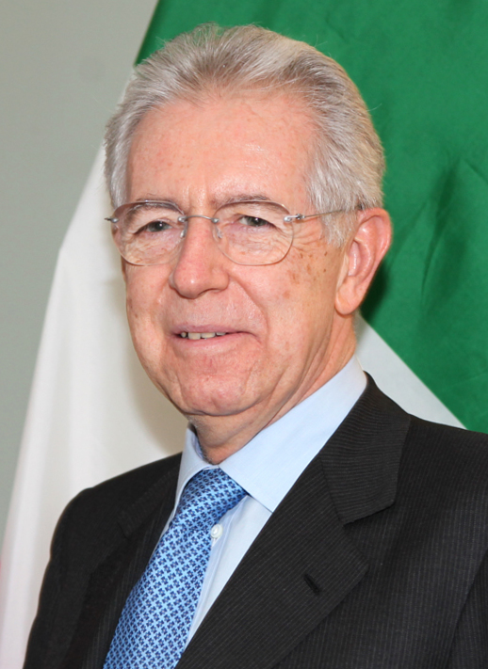
IMU (Imposta Municipale Unica)
Enacted by Monti in the end of 2011, levied from 2012 onwards, replacing ICI (Imposta Comunale sugli Immobili)
Largely not applicable to first homes, related to the definition of residency (art. 43, co. 2, Civil Code) - not to be confused with first-time buyers
Calculation includes the base value of the property, as well as location and economic benefits, with possible deductions (dependants, leases, etc…)
Paid annually (however, 2 installments)

Slide 7
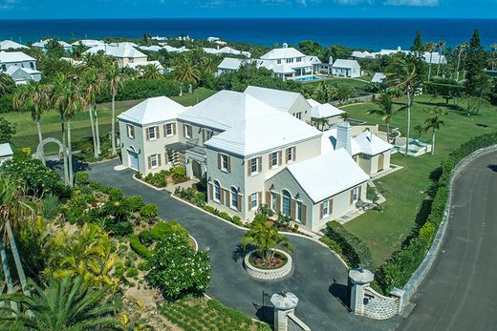
IVIE (Imposta sul Valore degli Immobili Situati all’estero)/ IVAFE (Imposta sul Valore degli Immobili Situati all’estero)
Both are levies on assets (property and financial assets) held abroad
IVIE extended to companies in 2021 to target tax avoidance
Different base values depending on whether the country the asset is located in has an exchange of information system with Italy
Any property taxes paid to foreign authorities can be deducted from the amount due in Italy
For IVAFE, different types of assets are included, irrespectively of how they were acquired
Potential deterrent? Any loopholes left?

Slide 8
Stamp duty on financial assets
Investments are taxed according to their value at FYE
On bank statements, flat amount based on the average balance, withheld directly by the bank
  34.2€ for individuals
  100€ for non-individuals

Slide 9
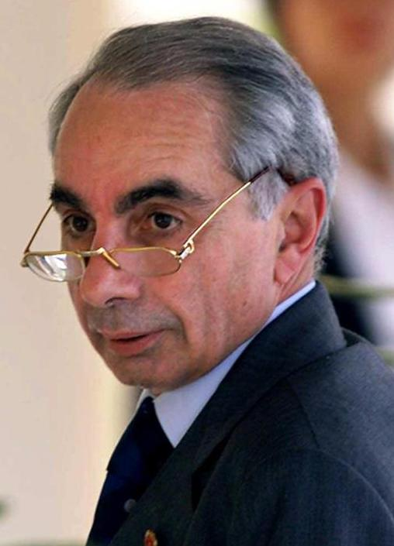
An extraordinary measure
1992 - to achieve a “balanced budget”
Urgent decree by PM Giuliano Amato
Fixed amount on bank account, as a percentage of overall balance
Only example of extraordinary measure regarding wealth taxes

Slide 10

30,000 ft view of other countries
Switzerland: Firstly established during the XIX century, the federal wealth tax was abolished in 1959 for individuals (1998 for corporations), but a wealth tax is levied in each of the 26 cantons:
  Currently under scrutiny, in favor of a tax targeting capital gains
  Generally speaking, different types of assets are included to calculate the base value
  Household items are generally excluded

Slide 11

30,000 ft view of other countries
Spain: General wealth tax levied at the national level, however regional governments can
Solidarity Tax introduced as a temporary measure for FYE 2022 (to complement the already existing wealth tax)
  In force for two years

Slide 12
Thank you for your collaboration
Merci pour votre collaboration
Grazie per la vostra collaborazione
Fabio Martello

