Slide 1


Slide 2

QUIRINAL TREATY SEMINAR
ENERGY TAXATION
ROVIGO
10-11/03/2023

Slide 3
ENERGY TAXATION AND THE CROSS-BORDER ISSUES
ROVIGO
10-11/03/2023

Slide 4

ENERGY TAXATION
ENERGY TAXES
taxes that the government imposes on the production, distribution, or/and consumption of energy, electricity, or fuels

Slide 5
ENERGY TAXATION GOALS
reduce CO2 emissions and environmental externalities
great and stable source of revenue for the government
improve specific services in the energy field
discourage activities that create adverse side effects for society
Pigovian taxes: taxes named after English economist, Arthur Pigou, who described how they can be used to change behaviours that impose costs on others

Slide 6
THE ENERGY TAXATION DIRECTIVE (2003/96/EC)
The ETD sets a minimum level of taxation that the Member states must apply. However differentiated rates of taxation may be applied by Member States, meaning that each state can design its own domestic taxes within the European framework
2008: the European Council asked the European Commission to adjust the Directive
2019: energy tax summary report
2021: a reform of the ETD has been announced

Slide 7
EDT REVISION
new structure of tax rates
tax rates based on the real energy content and environmental impact of fuels and electricity
minimum rates are also going to be based on current pricing and subject to annual revision
B. wider tax base
expand the taxable base including products or use of services that had been excluded from the 2003 ETD
remove favourable treatment of some sectors or fuels and reduce some allowed national exemptions

Slide 8
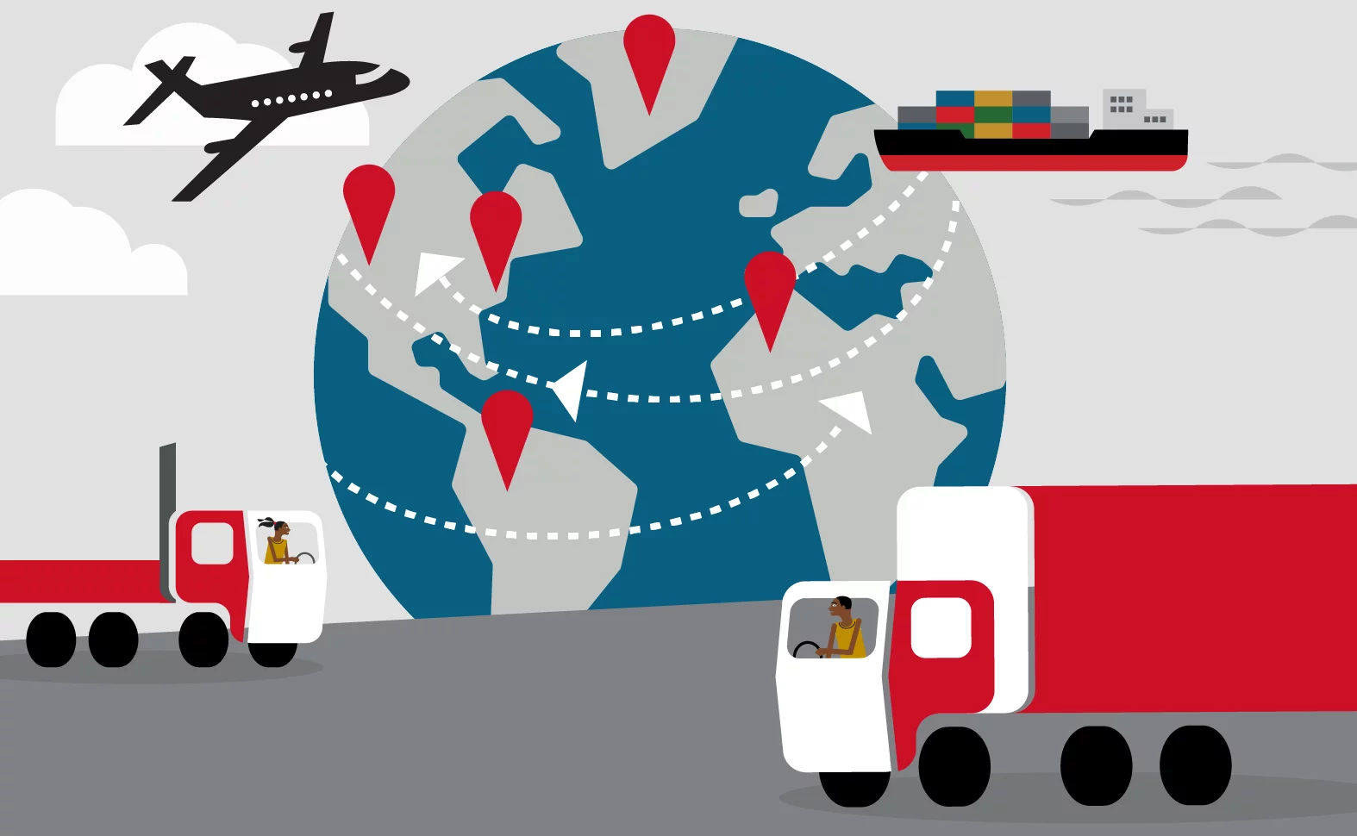
CROSS BORDER ISSUES
competition issues
carbon leakage
border tax adjustments (CBAM)
different national circumstances
political opposition
distribution issues

Slide 9

POSSIBLE REMEDIES??
revenues redistribution
CBAM exemptions
specific aid projects

Slide 10
CONCLUSION
To sum up, energy taxation is a fundamental form of income for governments and for the European Union, allowing them to improve and enrich their environmental goals. Although there might be some issues, particularly because of the involvement of a numerous amount of countries, each one of them with different characteristics, economic systems, assets, climate goals, etc., the focus needs always to be on how to take advantage of our knowledge to better ourselves and the world we’re living in.

Slide 11
Thank you for your attention
ELENA GARBIN

