Slide 1
Constitutional Profiles of the Windfall Profits Tax in the Light of Electricity Pricing Methods
Costanza Lugli
Ph.D candidate at University of Verona
Ferrara, 9th March 2023

Slide 2
Article 37 of Decree-Law No. 21/2022
2. The taxable base for the extraordinary solidarity contribution is the increase in the balance of asset and liability transactions for the period from 1 October 2021 to 30 April 2022 compared to the balance for the period from 1 October 2020 to 30 April 2021. In the event of a negative balance for the period from 1 October 2020 to 30 April 2021, a reference value of zero shall be used for the calculation of the tax base for this period. The contribution shall be applied at the rate of 25% in cases where the said increase exceeds EUR 5,000,000. The contribution is not due if the increase is less than 10%.
3. For the purposes of calculating the balance referred to in paragraph 2, the total amount of active transactions, net of VAT, and the total amount of passive transactions, net of VAT, indicated in the Communications of data on periodic VAT settlements, submitted, pursuant to Article 21-bis of Decree-Law No. 78 of 31 May 2010, converted, with amendments, by Law No. 122 of 30 July 2010, for the periods indicated in paragraph 2, shall be taken.

Slide 3
Article 37 of Decree-Law No. 21/2022
5. The contribution shall be settled and paid by 40%, as a down payment, by 30 June 2022 and the remainder, as the balance, by 30 November 2022, in accordance with the procedures set out in Article 17 of Legislative Decree No. 241 of 9 July 1997. By way of a provision issued by the Director of the Revenue Agency, after consulting with the Regulatory Authority for Energy, Networks and the Environment, the requirements, including declaratory requirements, and the procedures for the payment of the contribution are defined. With the same provision, additional data may be identified to be indicated in the invoices for the sale and purchase of the products referred to in paragraph 1, and the modalities for the exchange of information, also in massive form, with the Guardia di Finanza are defined.

Slide 4
Article 1 paragraphs 115-119 Finance Act 2023
116. The solidarity contribution is determined by applying a rate of 50% to the amount of that portion of the total income determined for corporate income tax purposes for the tax year prior to the one current on 1 January 2023 that exceeds the average of the total income determined for corporate income tax purposes earned in the four tax years prior to the one current on 1 January 2022 by at least 10%; in the event that the average of the total income is negative, a value of zero is assumed. The amount of the extraordinary contribution, in any event, may not exceed a portion equal to 25 per cent of the value of the net assets at the end of the financial year preceding the one in progress on 1 January 2022.

Slide 5
Article 15-bis of Decree-Law No. 4/2022 ("Decreto Sostegni ter")
1. As of 1 February 2022 and until 31 December 2022, a two-way compensation mechanism on the price of energy shall be applied with respect to electricity fed into the grid by:
(a) photovoltaic plants of more than 20 kW power that benefit from fixed premiums from the Conto Energia mechanism, which are not dependent on market prices;
b) solar, hydroelectric, geothermal and wind power plants with a power output of more than 20 kW that do not benefit from incentive mechanisms, which became operational prior to 1 January 2010.
[…]
4. Where the difference 3 is positive, the GSE shall pay the relevant amount to the producer. In the event that the aforesaid difference is negative, the GSE shall equalise or claim the corresponding amount from the producer.

Slide 6
Expected and actual results

Slide 7
Day-ahead market
In the MGP, hourly energy blocks are traded for the next day.
Participants submit bids/asks where they specify the quantity and the minimum/maximum price at which they are willing to sell/purchase.
Bids/asks are accepted after the closure of the market sitting based on the economic merit-order criterion and taking into account transmission capacity limits between zones. Therefore, the MGP is an auction market and not a continuous-trading market.
All the supply offers and the demand bids pertaining both to pumping units and consuming units belonging to foreign virtual zones that are accepted in the MGP are valued at the marginal clearing price of the zone to which they belong. This price is determined, for each hour, by the intersection of the demand and supply curves and is differentiated from zone to zone when transmission capacity limits are saturated.
The accepted demand bids pertaining to consuming units belonging to Italian geographical zones are valued at the “Prezzo Unico Nazionale” (PUN – national single price); this price is equal to the average of the prices of geographical zones, weighted for the quantities purchased in these zones.
GME acts as a central counterparty.

Slide 8
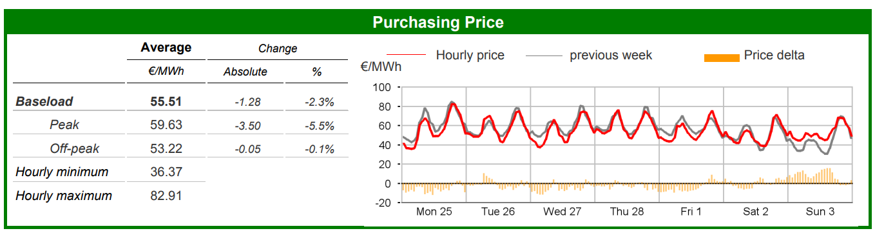
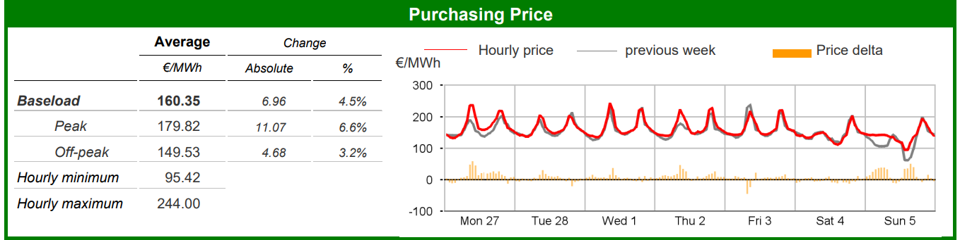
Electricity Markets - Day-Ahead Market (MGP)
Week no. 9 from 25 February to 3 March 2019
Electricity Markets - Day-Ahead Market (MGP)
Week no. 9 from 27 February to 5 March 2023

Slide 9
Ratio
The ratio of the levy is to hit the extra profits of energy companies directly related to the increase in prices and tariffs generated by the economic and humanitarian effects of the Ukrainian crisis.

Slide 10

Electricity Pricing System effect
the price paid to all operators in the sector is the price paid to the auction participant with the highest price
this price also results in higher costs for fossil fuel operators
that no (or almost no) extra profits are generated for them
that the extra profits generated for companies in the renewables sector are intercepted upstream, and therefore at the time when the extraordinary contribution operates there are none

Slide 11
Conclusions
The extraordinary contribution, both in the formulation for 2022 and in the formulation for 2023, must be considered an unreasonable provision because it is contrary to the ratio set by the legislature itself, and consequently suffers from a defect of constitutionality

Slide 12
Thanks for your attention!
Costanza Lugli
Ph.D candidate at University of Verona

